Slide 1
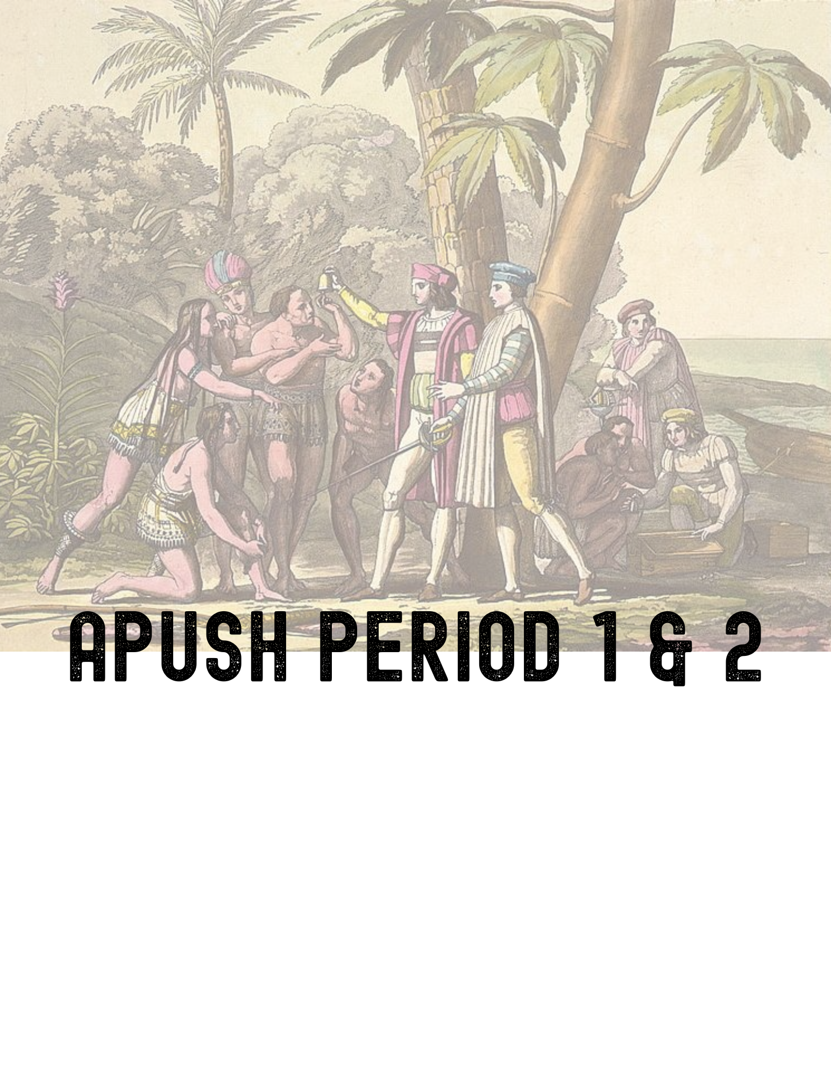
NAME:
TABLE OF CONTENTS
PRINCETON REVIEW NOTES ………………………..…..… pgs. 2 - 6
CRASH COURSES ……………………………………………..… pgs. 7 - 12
TIMELINE …………………….………………………………….… pgs. 13 - 15
LEARNING TARGETS ….……………………………………… pgs. 16 - 17
LEARNING TARGETS:
We will complete throughout the unit in class

Slide 2
APUSH PERIOD 1 & 2 PACKET
Take notes from your reading. Highlight any key terms.
PRINCETON REVIEW NOTES
EARLY COLONIZATION OF THE NEW WORLD (1491-1607) - pg. 153 - Chapter 6
The Early Colonial Era: Spain Colonizes the New World
Competition for Global Dominance
The English Arrive
French Colonization of North America

Slide 3
The Pilgrims & Massachusetts Bay Company
Other Early Colonies
Comparison of the 4 Colonizing Powers
Spain | France | The Netherlands | England

Slide 4
Native American Conflict
Powhatan Wars
Pequot War
King Philip’s War
Pueblo Revolt
Slavery in the Early Colonies

Slide 5
THE AGE OF SALUTARY NEGLECT (1650 - 1750)
English Regulation of Colonial Trade
Colonial Governments
Major Events of the Period

Slide 6
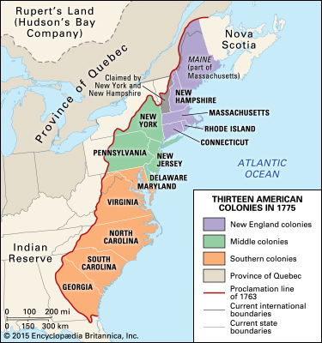
Life in the Colonies
Describe the colonies.
New England
Middle Colonies
Southern Colonies
similarities and differences

Slide 7
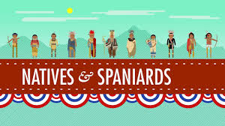
The Black Legend, Native Americans, and the Spanish: Crash Course US History #1
1. Describe native North Americans before the arrival of Europeans.
2. What happened to native populations due to disease?
3. Describe characteristics of most native groups and distinct groups mentioned in the Thought Bubble (Historical Thinking Skills:
Comparison)
4. How did many Europeans perceive Native Americans?
https://www.youtube.com/watch?v=6E9WU9TGrec&t=1s

Slide 8
5. Describe Spanish colonization of Florida & New Mexico
6. Describe Pope’s Rebellion & its effects. (Historical Thinking Skills: Causation)
7. Summarize the message of the “Mystery Document.” (include the author’s name)
8. Explain the ideas of the “Black Legend” & how it was used by the English.
9. What point does John Green make about primary sources at the end of this video?

Slide 9
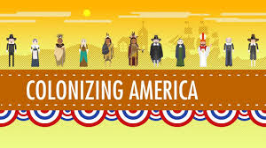
When is Thanksgiving? Colonizing America: Crash Course US History #2
1. What were the first settlers looking for?
2. What happened to the English colony on Roanoke Island?
3. Explain the purpose behind the creation of Jamestown & what happened to the first colonists
4. Explain the purpose of the headright system and describe indentured servitude
5. How did tobacco change the Jamestown colony?
https://www.youtube.com/watch?v=o69TvQqyGdg&t=386s

Slide 10
6. Describe the Maryland Colony
7. Describe the differences between Pilgrims & Puritans. [HISTORICAL THINKING SKILL: Comparison]
8. Explain the significance of the Mayflower Compact
9. Who was Squanto?
10. Describe the “City Upon a Hill” and its significance, including the “mystery document” information.
11. Why were Roger Williams and Anne Hutchinson banished? What does this show about religious policies of the colonies, especially in New England? [HISTORICAL THINKING SKILL: Causation]

Slide 11
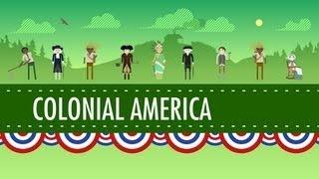
The Quakers, The Dutch and the Ladies: Crash Course US History #4
1. Describe the Dutch Colonies
2. Explain the founding of the colony of Pennsylvania
3. Describe the values of the Quakers
4. Explain the complaints against governor Berkeley in the “mystery document”
https://www.youtube.com/watch?v=p47tZLJbdag&t=17s

Slide 12
5. Describe Bacon’s Rebellion and its effects (Historical Thinking Skill: Causation)
6. What did King James II attempt to do in 1686? What was the outcome of these policies? (Historical Thinking Skill: Causation)
7. What was the Toleration Act of 1690?
8. Describe the Salem Witch Trials.
9. Describe the colonial economy and society. (Be sure to include indentured servants and women)

Slide 13
Describe each event. Use the reading notes, videos & Google
PERIOD 1 & 2 TIMELINE
1492 - Columbian Exchange begins with Columbus's discovery of the New World
1512 - Encomienda system created
1520 - Smallpox begins to decimate native population
1552 - Bartolome De las Casas popularizes the idea of the “Black Legend” (google it)
1607 - Jamestown est. ( include John Smith & John Rolfe)
1609 - 1613 - Anglo-Powhatan War
1618 - Headright system created

Slide 14
1619 - Virginia House of Burgesses created
1620 - Plymouth Est. (include Mayflower Compact)
1632 - colony of Maryland est.
1635 - Roger Williams exiled
1637 - Anne Hutchinson banished
1639 - Fundamental Orders created (google it)
1643 - New England Federation est.
1651 - Navigation Laws/Mercantilism

Slide 15
1676 - Bacon’s Rebellion
1686 - Dominion of New England est. (include Sir Edmund Andros)
1693 - Salem Witch Trials
1730s and 1740s - Great Awakening
1733 - Zenger Trial (google it)
1754 - 1763 - French & Indian War

Slide 16
We will complete in class
PERIOD 1 & 2 LEARNING TARGETS
I can describe the defining features of Pre-Columbian Native American groups and evaluate the ways geography shaped those characteristics. (KC 1.2)
I can explain the effects of the initial European contact with the Americas, including the Columbian Exchange. (KC 1.3 & 1.4)
I can describe the encomienda system and both Native & European responses to Spanish colonization. (KC 1.5)
I can compare the goals of Europeans in exploration and conquest and analyze how that affected their interactions with Natives. (KC 1.3, 1.5, 1.6 & 2.2)

Slide 17
I can discuss the unique characteristics of the British colonies on the Atlantic seaboard by region and by colony. (KC 2.3)
I can describe the transatlantic trade system that developed and how it advanced mercantilist goals. (KC 2.4)
I can identify examples of cooperation & conflict between Natives and Europeans (KC 2.5)
I can track the causes and effects of the rise of slavery in the colonies. (KC 2.6)
I can describe the development of political institutions in the British colonies and evaluate the extent to which they were democratic. (KC 2.7)

